Slide 1
Data View
6

Slide 2
Today’s Agenda
Data View
Data Abstraction
Schema and Instances
Three schema architecture

Slide 3
Data View
A database system is a collection of interrelated files and a set of programs. A major purpose of a database system is to provide users with an abstract view of data means the system hide certain details of how data are stored and maintained. Hiding irrelevant details from user and providing abstract view of data to users, helps in easy and efficient user-database interaction.

Slide 4
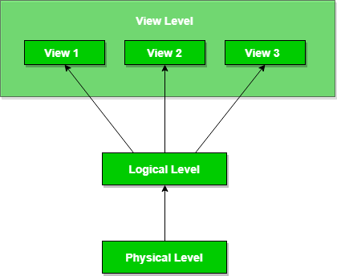
Data Abstraction in DBMS
Database systems are made-up of complex data structures. To ease the user interaction with database, the developers hide internal irrelevant details from users. This process of hiding irrelevant details from user is called data abstraction.

Slide 5
Data Abstraction in DBMS
We have three levels of abstraction:
Physical level: This is the lowest level of data abstraction. It describes how data is actually stored in database. You can get the complex data structure details at this level.
Logical level: This is the middle level of 3-level data abstraction architecture. It describes what data is stored in database.
View level: Highest level of data abstraction. This level describes the user interaction with database system.
Example: Let’s say we are storing customer information in a customer table. At physical level these records can be described as blocks of storage (bytes, gigabytes, terabytes etc.) in memory. These details are often hidden from the programmers.
At the logical level these records can be described as fields and attributes along with their data types, their relationship among each other can be logically implemented. The programmers generally work at this level because they are aware of such things about database systems.
At view level, user just interact with system with the help of GUI and enter the details at the screen, they are not aware of how the data is stored and what data is stored; such details are hidden from them.

Slide 6
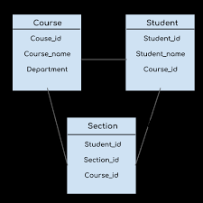
Schema
Overall design of a database is called the schema. Schema is of three types: Physical schema, logical schema and view schema.
The design of a database at physical level is called physical schema, how the data stored in blocks of storage is described at this level.
Design of database at logical level is called logical schema, programmers and database administrators work at this level, at this level data can be described as certain types of data records gets stored in data structures, however the internal details such as implementation of data structure is hidden at this level (available at physical level).
Design of database at view level is called view schema. This generally describes end user interaction with database systems.

Slide 7
Instances
he data stored in database at a particular moment of time is called instance of database. Database schema defines the variable declarations in tables that belong to a particular database; the value of these variables at a moment of time is called the instance of that database.
For example, lets say we have a single table student in the database, today the table has 100 records, so today the instance of the database has 100 records. Lets say we are going to add another 100 records in this table by tomorrow so the instance of database tomorrow will have 200 records in table. In short, at a particular moment the data stored in database is called the instance, that changes over time when we add or delete data from the database.

Slide 8
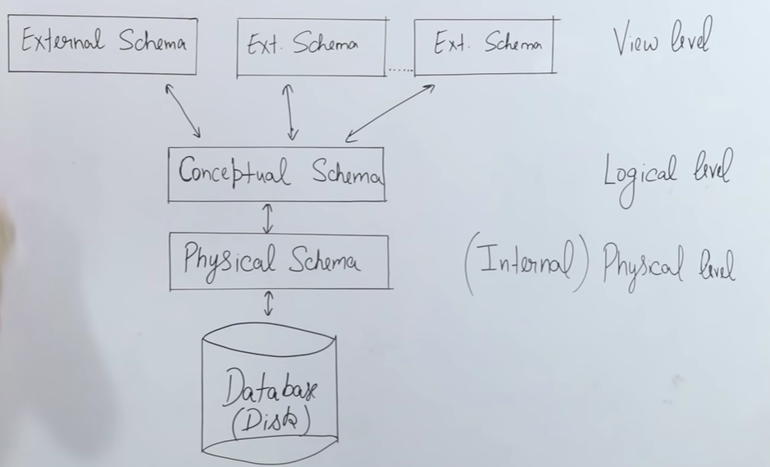
Three schema architecture

Slide 9
Three schema architecture
External level
It is also called view level. The reason this level is called “view” is because several users can view their desired data from this level which is internally fetched from database with the help of conceptual and internal level mapping.
Conceptual level
It is also called logical level. The whole design of the database such as relationship among data, schema of data etc. are described in this level. Database constraints and security are also implemented in this level of architecture. This level is maintained by DBA or the designer.
Internal level
This level is also known as physical level. This level describes how the data is actually stored in the storage devices. This level is also responsible for allocating space to the data. This is the lowest level of the architecture.

Slide 10


